Slide 1
Contents
Literature Survey
Working Principle
Methodology
System Layout
Governing Equations
Simulation Results
Packaging Data
Claimed Points
References

Slide 2
Selection (Literature Survey)
The first task of designing a robot is to select a configuration of the robot based on the required workspace, which here is a cuboid of 100 x 40 x 70 cm³.
As briefed in the book – “Robotics and Control^{[1]}”, to reach a point in 3D space, a 3DOF manipulator is required, which includes the following:
Cartesian Configuration (PPP) – Cuboidal Workspace
Cylindrical Configuration (RPP) – Cylindrical Workspace
Polar Configuration (RRP) – Hemispherical Workspace
Articulated Configuration (RRR) – Hemispherical Workspace
We selected Cartesian Configuration for the job at hand, as it provides a cuboidal workspace and is simpler than the other robots.
Revolute joints mostly require costly motors compared to prismatic joints with similar payload, not to mention the easy availability of parts for the later.

Slide 3
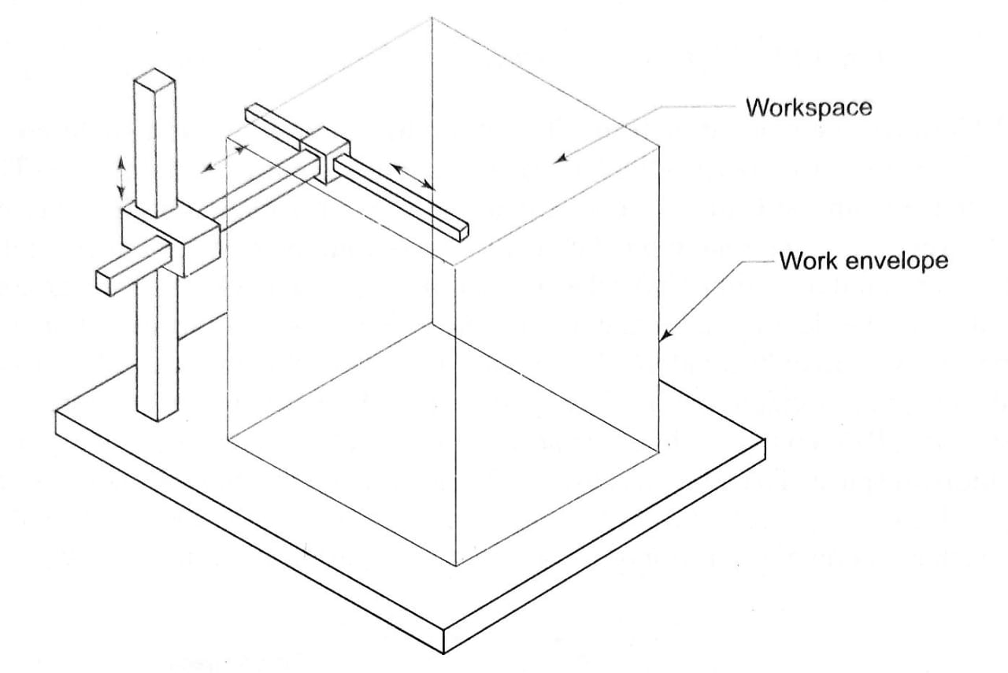
Workspace (Literature Survey)
Workspace of a robot defines the co-ordinates that can be travelled by the end effector. “Analytical work is used to determine the spatial configuration of the robot”^{[2]}.
Figuring out the workspace of a Cartesian robot is pretty straight-forward and few considerations of the link lengths can easily result in an optimized robot.
For our work, we took the following links with all prismatic joints:
Ground Link = 100cm
Vertical Link = 70cm
Horizontal Link = 40cm
The above configuration would, however, only allow the plug to move in the 3D space but would not bring any change to its orientation in the space. More on this has been discussed later in the presentation.

Slide 4
Manipulator Control (Literature Survey)
Due to various disturbances, and dynamic effects of one joint on the other, a closed loop controller becomes important.
Disturbances in robotic manipulators may include joint frictions, unknown payloads, varying contact points, and unmodeled dynamics.^{[3]} Various attempts have been made in developing observers for such disturbances as cited in the article by A. Mohammadi et al. ^{[3]}
To better account for such disturbances and to get a better accuracy, feed-forward compensators were used. They reduce the effect of the disturbances by countering them before the input is given to the plant.
For detailed information on feed-forward compensators or to see proof of their effects, please refer to the article by A. P. Montoya-Ríos et al. ^{[4]}

Slide 5
Tuning (Literature Survey)
Considering the non-linear nature of manipulator controllers and the use of feed-forward compensators, it is quite tedious and impractical to manually tune the parameters.
H-infinity Tuning was used to tune the parameters.
It is a method in which the controller is optimized by iteratively finding the controller parameters which outputs a gain in the limits specified. ^{[5]}
For the same, looptune command^{[6]} in MATLAB along-with slTuner interface^{[7]} was used.
[Imgs on Feed-forward Compensators and Tuning]

Slide 6
Controller Layout (Methodology and System Layout)

Slide 7
Inverse Kinematics (Gov. Eq.)

Slide 8
PID with Feed-Forward Compensator (Gov. Eq.)

Slide 9
Signal Generation (Gov. Eq.)

Slide 10
Simulation Results

Slide 11
References
Robotics and Control
Kinematic Analysis and Workspace Calculation of a 3-DOF Manipulator
Nonlinear disturbance observer design for robotic manipulators
Simple Tuning Rules for Feed-forward Compensators Applied to Greenhouse Daytime Temperature Control Using Natural Ventilation.
https://en.wikipedia.org/wiki/H-infinity_methods_in_control_theory#:~:text=H%E2%88%9E%20(i.e.%20%22H%2D,controller%20that%20solves%20this%20optimization.
https://in.mathworks.com/help/control/ug/tuning-feedback-loops-with-looptune.html
https://in.mathworks.com/help/slcontrol/ug/sltuner.html

